Slide 1



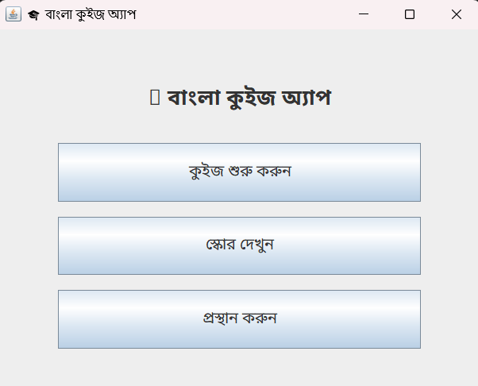


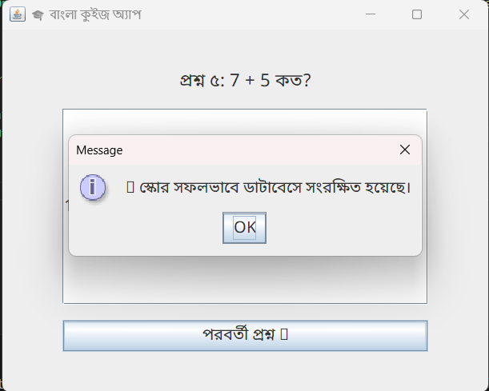
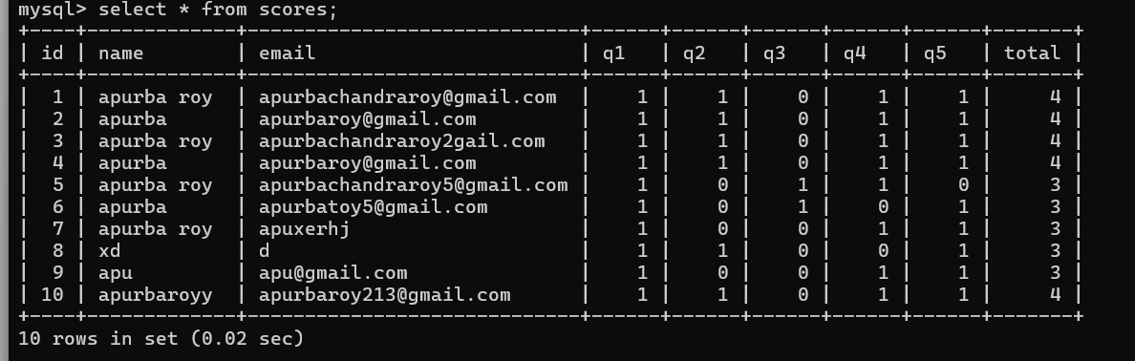
Developer: Apurba Chandra Roy
ID: IT23031
Department of ICT
Mawlana Bhashani Science and Technology University
Bangla Quiz App
A Bengali Language Based Interactive Quiz System
Using Java Swing and MySQL
Developer: Apurba Chandra Roy
ID: IT23031
Department of ICT
Mawlana Bhashani Science and Technology University
1.Introduction:
7. Leaderboard Logic:
Key features:
Bengali-language user interface
Interactive quiz system with instant feedback
Automatic score calculation and result display
Secure storage of quiz results using MySQL
Simple and easy-to-use design
Input validation and error handling for better reliability
Presentation Layer: Handles user interaction through Java Swing components
Application Layer: Manages quiz logic, validation, and score processing
Data Layer: Stores user information and quiz results in a MySQL database accessed via JDBC
This architectural design separates different responsibilities and makes the system easier to manage and extend.
The Bangla Quiz App is a desktop-based quiz application developed using Java Swing and MySQL to address this issue. The application provides a fully Bengali-language interface where users can participate in quizzes, receive instant feedback, and have their results stored securely. This project highlights the practical use of GUI programming, event handling, and database connectivity in Java..
The Leaderboard system executes an optimized SQL query to rank students. It fetches the maximum score of each user for a specific category and sorts them in Descending Order.
Query Logic:
SELECT username, score, category FROM scores ORDER BY score DESC;
2. Project Objectives:
In Databases:
Develop a Bengali-language quiz application
Design a user-friendly graphical interface
Store quiz results securely in a database
Provide instant feedback and score calculation
Demonstrate Java GUI and database connectivity skills
5. System Workflow:
The user launches the application and enters basic information
Quiz question are shown one by on the screen
The user submits answers for each question
The system checks the answer and calculator the scores
Quiz results are saved in the databases
The user can view previously stored scores when needed
3. Methodology:
The project is developed following a modular approach. The graphical user interface is created using Java Swing, where multiple panels are managed with CardLayout for smooth navigation. Quiz logic, answer validation, and score calculation are handled within the application layer.
For data storage, JDBC is used to connect the Java application with a MySQL database. After the quiz is completed, user information and scores are validated and stored in the database using prepared statements to maintain data accuracy and security.
Database Schema:
The system uses a MySQL database with a table named scores to store quiz information.
Table: scores
name: Stores the user’s name
email: Stores the user’s email address
q1 – q5: Stores individual question results (correct or incorrect)
total: Stores the final quiz score
This database structure ensures organized and efficient storage of quiz data.
4. System Architecture:

